Slide 2
Diverse genotypes and variants of African swine fever virus in Nigeria: the need for continuous surveillance
Adeyinka Jeremy Adedeji
National Veterinary Research Institute, Vom Nigeria

Slide 3
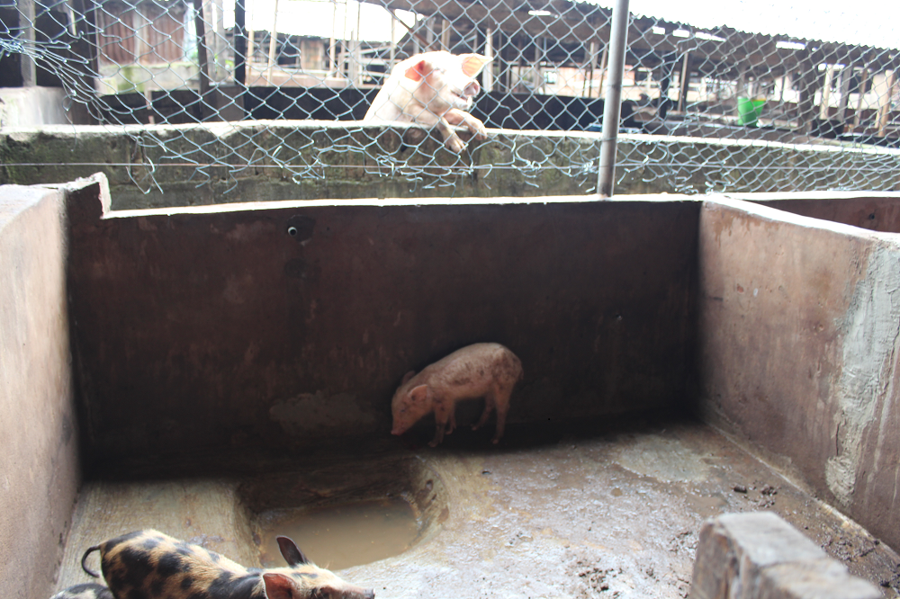
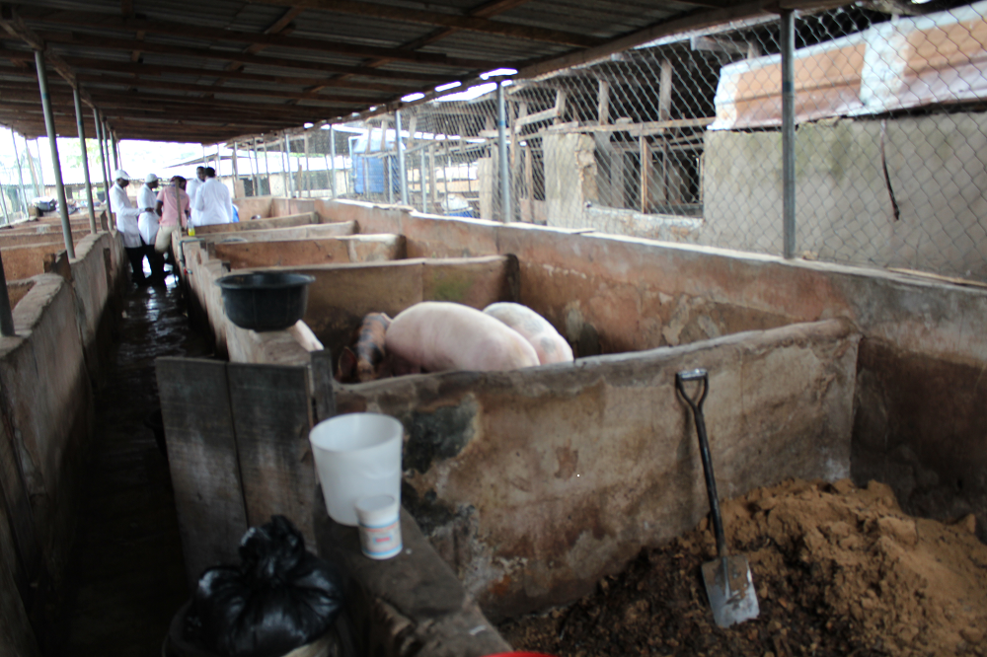
Background
Nigeria has a population of over 7 million pigs
Pig husbandry system in Nigeria is differentiated into mostly free-roaming/extensive, semi-intensive intensive pig production systems in pig-producing areas in Northern Nigeria
Intensive commercial/communal pig estates in Southern Nigeria

Slide 4
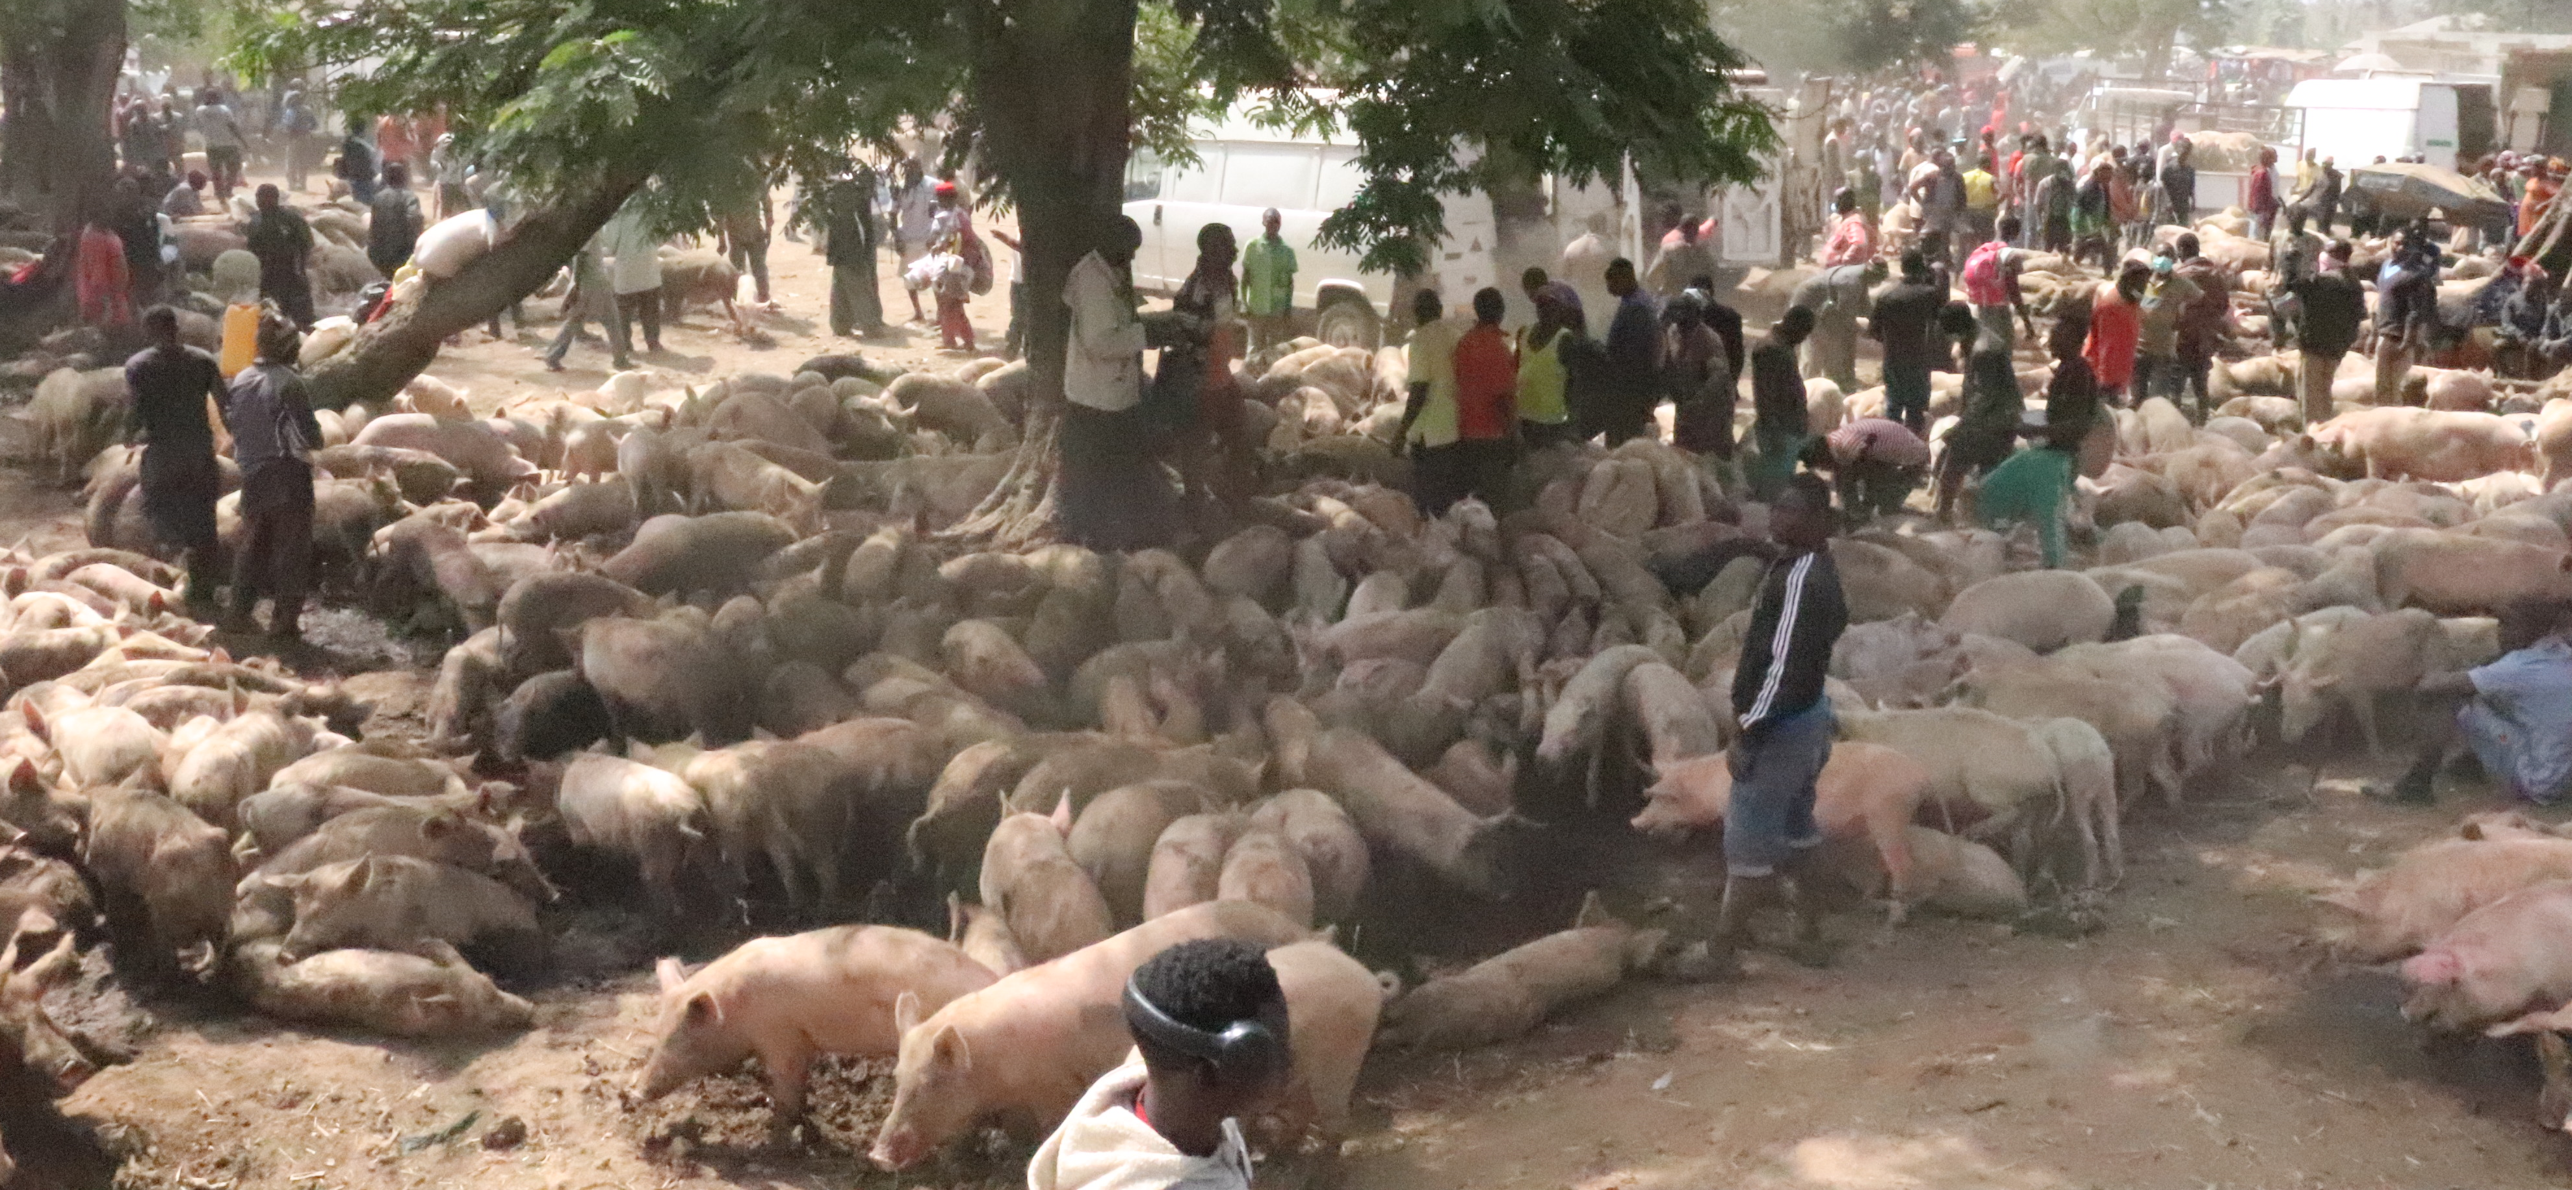
Background
African swine fever virus(ASFV) was first introduced into Nigeria in 1997 via the trading of live pigs along the Benin Republic-Nigerian border
Most reports of ASF outbreaks in Nigeria have been in domestic pigs, but ASFV has also been reported in forest pigs and warthog
Due to cultural reasons, demand for live pigs in Nigeria is high and these pigs are mostly sold through live pig markets
Live pig markets in Nigeria are hotspots of ASF

Slide 5
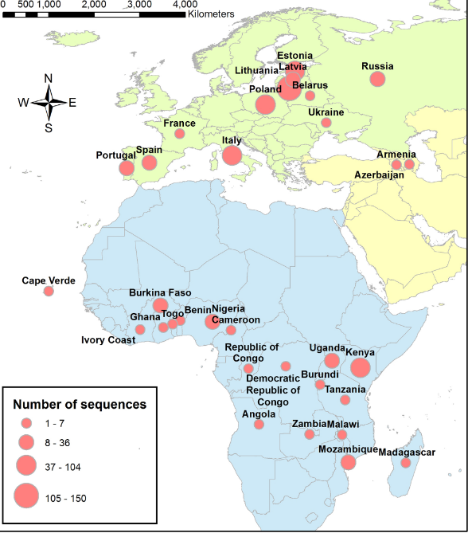
Background
ASFV is a relatively stable DNA virus with low mutation rates and no closely related viruses
However, certain regions of the virus such as the CVR of the B602L gene are prone to mutations leading to the creation of new ASFV variants
Molecular characterization of ASFV can be used for investigating the source and extent of outbreaks and possible genetic diversity of circulating viral strains
Limited genetic information is available in the public domain on Nigerian ASFVs
The epidemiology and probable drivers of the disease in Nigeria are poorly understood
Genetic characterization of circulating ASFV to shed light on possible insights into the course
and characteristics of these outbreaks
Alkhamis et al., 2018

Slide 6
Methods
Molecular characterization of Nigeria ASFVs (2016-2021)
ASFV positive characterized (60)
Selected ASFV genes were characterized:
The regions were the C-terminal end of the B646Lgene encoding the p72 protein,
Full length of E183L gene encoding p54 protein,
Central variable region (CVR) within the B602L
CD2v protein encoding the EP402R gene
Sequences deposited in the Genbank

Slide 7
Results

Slide 8
Togo/09 (KT368176)
IC96 (FJ174379)
CV97 (FJ174380)
CAM/82 (AF301544)
Cam 2009/02 (JX310034)
Burkina Faso/09 (KT368178)
BEN/1/97 (AF302816)
ANG 2011/01 (JX310041)
IC-SP/14/1
IC-MDG/14/1
ANG/70 (AF301542) G1
Ang72 (FJ174378) G1
Nig (KT961331)
Nig (KT150898)
Nig (KT150895)
86
Nig (KT150878)
Genotype I
Nig71 DWK288T
Nig69 NUM424
Nig67 218I
Nig65 217B
Nig64 GW2
Nig58 SH383
Nig40 CD653
Nig37 AK5
Nig36 Kaf164
Nig35 Kaf253
Nig29 Og2
Nig11 KFC41
Nig10 DWK286
Nig2 CR65T
Nig3 CR58T
Ghana/09 (KT368177)
87
Genotype XVII
MOZ 12/2006 (KY353991)
MOZ 9/2006 (KY353988)
Nig21 LA47
Nig23 LA49
Nig30 Og1
Nig33 Edo1
Nig38 CD698
Nig42 CD664
Nig53 DT1
Nig55 AN4
Genotype II
Nig57 AB31
Nig59 OS7B
Nig70 Oyo5
Nig75 CD652
Georgia/2007 (AM999764) G2
73
MAD/1/98 (AF270706) G2
MOZ-60/98 (AY274455) G2
MOZ/2002/2 (AY351518) G2
LUS93/1 (AY351563) G2
NAM/1/95 (DQ250122) G18
87
Genotype V
87
Genotype VI
Neighbour‐joining tree, of the partial p72 gene, showing the genetic relationships between the Nigeria 2019 (in blue) 2020 (in red) and 2021 (in green) ASF outbreak isolates and representatives of the known ASFV genotypes. The evolutionary distances were computed using the Maximum Composite Likelihood method. Only the bootstrap values greater than 70% are shown. The isolates from this study are highlighted with red squares
99
Genotype VII
99
Genotype XXI
SPEC/245 (DQ250117) G22
71
Genotype III
Genotype XXIV
Genotype XX
RSA/1/99/W (AF449477) G4
Genotype XIX
NYA/12 (AY351555) G14
Genotype XV
70
88
Genotype XVI
SUM/1411 (AY351542) G13
85
Genotype XII
KAB/62 (AY351522) G11
93
Genotype XXIII
97
Genotype VIII
88
99
Genotype IX
Genotype X
0.005
99

Slide 9
Nig69 NUM424
Nig71 DWK288T
Nig67 218I
Nig65 217B
Nig64 GW2
Nig58 SH383
Nig40 CD653
Nig37 AK5
Nig36 Kaf164
Nig35 Kaf253
Nig29 Og2
Nig11 KFC41
Nig10 DWK286
98
Nig3 CR58T
Nig2 CR65T
GIa
Nig (KT150945)
Nig (KT150960)
Genotype I
Nig (KT150962)
Nig (KT961350)
ANG70 (EU874327) GIa
Brazil78 (FJ238535) GIa
81
OURT 88/3 (AM712240) GIa
E75 (FJ174394) GIa
Haiti (FJ238536) GIa
E70 (FJ174389) GIa
Malta (FJ174419) GIa
Co62 (FJ174387) GIa
IC-SP/14/2
IC-MDG/14/2
GIb
GIb
GIb
98
GIc
GId
MAD198 (KC662387) GII
Nig21 LA47
Nig23 LA49
Nig30 Og1
99
Nig33 Edo1
Nig38 CD698
Nig53 DT1
Genotype II
72
Nig42 CD664
98
Nig55 AN4
Nig57 AB31
Nig59 OS7B
Nig70 Oyo5
99
Nig75 CD652
Genotype III
Genotype XXII
Genotype XXI
99
Genotype IV
Genotype XXa
Minimum Evolution tree, based on the full p54 gene, showing the genetic relationships between the Nigeria 2019 (in blue) 2020 (in red) and 2021 (in green) ASF outbreak isolates and representatives of the known ASFV genotypes. The evolutionary distances were computed using the Kimura 2‐parameter method. Only the bootstrap values greater than 70% are shown.
81
Genotype XXb
87
Genotype V
78
Genotype XI
73
Genotype XIV
Genotype XIII
93
Genotype XV
93
Genotype X
Genotype IX
99
Genotype XXIII
99
Genotype XVII
Genotype XVIII
99
Genotype XVI
0.05

Slide 10
Nig59 OS7B
Nig75 CD652
Nig70 Oyo5
Nig57 AB31
Nig55 AN4
Nig30 Og1
Nig33 Edo1
76
Nig42 CD664
Serogroup 8
Nig21 LA47
Nig23 LA49
Nig38 CD698
99
Nig53 DT1
ASFV Georgia 2007 1 (FR682468)
ASFV Krasnodar 2012 dom (KM609342) SG8
ASFV Krasnodar 2012 (KJ195682)
ASFV Volgograd 2012 wb (KM609363)
ASFV Rhodesia (KM609354)
ASFV Magadi (KM609348) SG
ASFV Malawi Lil-20 1 1983 (AY261361)
Serogroup 5
Serogroup 6
88
ASFV Mkuzi 1979 (AY261362)
Serogroup 3
ASFV Bartlett (KM609335) SG
ASFV Killearn (KM609372) SG
100
Serogroup 2
ASFV DAvis (KM609336) SG
85
ASFV Warmbaths (AY261365)
ASFV 26544 OG10 Italy (KM102979)
ASFV 47 Ss 2008 Sardenia (KX354450)
ASFV BA71V (U18466) SG4
ASFV strain NH-P68 (AY463915)
ASFV Benin 97 1 (AM712239)
Nig71 DWK288T
Nig2 CR65T
Maximum‐likelihood tree based on the partial amino acid sequence of the CD2v protein, showing the relationship between the Nigeria 2019 (in blue) 2020 (in red) and 2021 (in green) ASF outbreak isolates and representatives of known ASFV serogroups as well as ASFVs clustering outside the eight established serogroups. The General Reversible Chloroplast model Gamma distribution was used. Only the bootstrap values greater than 70% are shown.
Nig3 CR58T
Nig10 DWK286
100
Nig11 KFC41
Serogroup 4
Nig29 Og2
Nig35 Kaf253
Nig36 Kaf164
Nig37 AK5
Nig40 CD653
Nig58 SH383
Nig64 GW2
Nig65 217B
Nig67 218I
Nig69 NUM424
100
Serogroup 7
Serogroup 1
0.05
99

Slide 11
CVR profiles of the Nigerian African Swine Fever virus Genotype I (1998-2020)
 | Isolate name | Year | CVR | Number of repeats | Genotype based on P72 | Reference
1 | 98/ASF/NG | 1996 | ABNAAAACBNAAAAACBNAAAAACBNAAAACBNAFA | 36 | I | Odemuyiwa et al 2001
2 | PACE pig 2 | 2004 | ABNAAAACBNAAAACBNAFA | 20 | I | Owolodun etal 2007
3 | Makurdi pig | 2005 | ABNAAAACBNAAAAACBNAFA | 21 | I | Owolodun etal 2007
4 | OJ pig 1 | 2006 | ABNAAAAACBNAAAACBNAAAAACBNAFA | 29 | I | Owolodun etal 2007
5 | Nig13_KAF_14 | 2007 | ABNABNAAAAACBNAFA | 17a | I | Luka et al 2016
6 | Nig08/BNGb9 | 2008 | ABNAAAACACBNAAAACBNAFA | 22 | I | Alkhamis et al. 2018
7 | Nig08/Cr15 | 2008 | ABNAAAAACBNAAAAAACBNAFA | 23 |  | Alkhamis et al. 2018
8 | Nig08/BNGb4 | 2008 | ABNAAAACBNAAAACBNAAAACBNAFA | 27 | I | Alkhamis et al. 2018
9 | Nig08/LAOk2 | 2008 | AAACBNAAAAAACBNAAAAAACBNAAAAB | 37 | I | Luka et al 2016
10 | Nig11_KAF_14 | 2014 | ABNABNAAAAACBNA | 15 | I | Luka et al 2016
11 | Nig29_LGTT5_15 | 2015 | ABNAAAACAAACBNAFA | 17b | I | Luka et al 2016
12 | Nig6_JS10_13 | 2015 | ABNAAAACBNAAAACBNAAAACBNAAAACBNAAAACBNAAAACBNAFA | 48 | I | Luka et al 2016
13 | IMO06 | 2017 | ABNAAAAACBNAAAACBNAFA | 21b | I | Masembe et al., 2022
14 | ENU09 | 2017 | ABNAAAACBNAAAAAACBNAAAAAACBNAFA | 31 | I | Masembe et al., 2022
15 | ZNG21 | 2018 | ABNAAAACBNAAAAAAAAACBNAAAAAACBNAFA | 34 | I | Masembe et al., 2022
16 | Nig2_CR65T | 2019 | ABNAAAACBNAAAAAACBNAAAAAACBNAAAAAACBNAAAAAACBNAFA | 49 | I | Unpublished
17 | Nig10_DWK286 | 2019 | ABNAAAACBNAAAACBNAAAACBNAAAACBNAAAACBNAFA | 41 | I | Adedeji et al 2022
18 | Nig69_NUM424 | 2019 | ABNAAAACBNAAAAAACAACBNAAAAACBNAFA | 33 | I | Adedeji et al 2022
19 | Nig37_AK5 | 2020 | ABNAAAACBNAFA | 13 | I | unpublished
20 | Nig_KAF199 | 2020 | ABNAAAACBNAAACBNAAAACBNAFA | 26 | I | Adedeji et al 2022
21 | Nig_KAF163 | 2019 | ABNABNAAAAAACBNAFA | 18 | I | Adedeji et al 2022
22 | Nig40_CD653 | 2020 | BNDBNDBNAA | 10 | 1 | unpublished

Slide 12
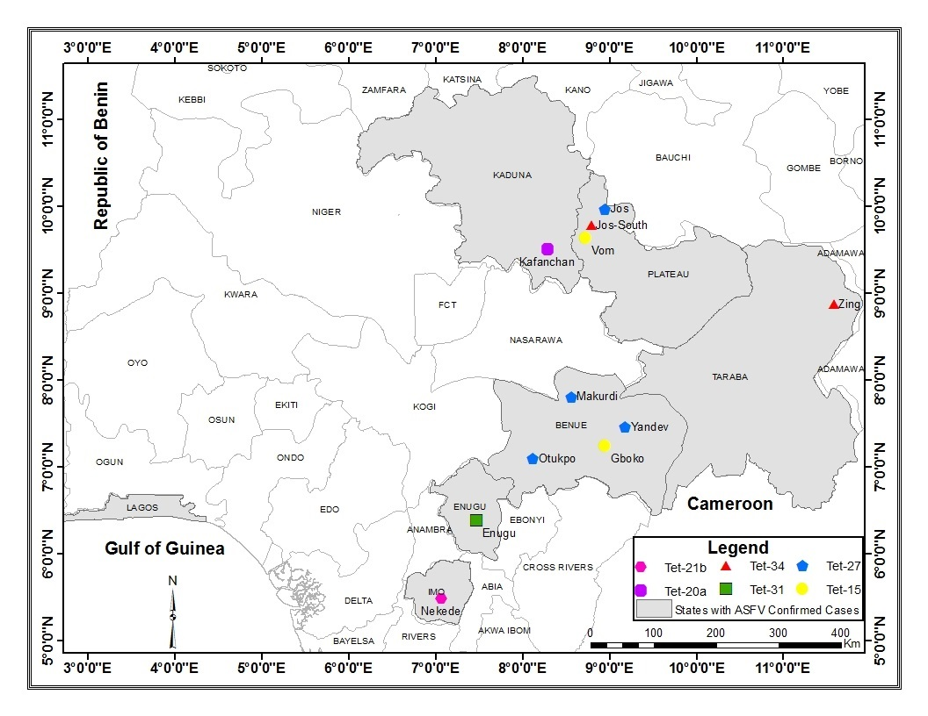

Slide 13
CVR variants of African Swine Fever virus Genotype I reported in selected Western African countries and Nigeria
 | Country | Number of ASFV genotype I variants reported | ASF genotype I variants also found in Nigeria | References
1 | Benin | 4 | 20, 22, 29, 36 | Minoungou et al., 2020
2 | Cameroon | 4 | 20, 21 | Wade et al., 2019
3 | Bukina Faso | 10 | 22, 29, 34, 49, | Minoungou et al., 2020
4 | Ivory Coast | 4 | 20, 36 | Couacy-Hymann et al. 2018
6 | Ghana | 6 | 36,48 | Minoungou et al., 2020

Slide 14
CVR profiles of the Nigerian African Swine Fever virus Genotype II (2020)
Isolate name | CVR | Number of repeats | Genotype based on P74 &P54
Nig21_LA47 | BNDBNDBNAA | 10 | II
Nig23_LA49 | BNDBNDBNAA | 10 | II
Nig30_Og1 | BNDBNDBNAA | 10 | II
Nig33_Edo1 | BNDBNDBNAA | 10 | II
Nig38_CD698 | BNDBNDBNAA | 10 | II
Nig42_CD664 | BNDBNDBNAA | 10 | II
Nig53_DT1 | BNDBNDBNAA | 10 | II
Nig55_AN4 | BNDBNDBNAA | 10 | II
Nig57_AB31 | BNDBNDBNAA | 10 | II
Nig59_OS7B | BNDBNDBNAA | 10 | II
Nig70_Oyo5 | BNDBNDBNAA | 10 | II
Nig75_CD652 | BNDBNDBNAA | 10 | II

Slide 15
Conclusion
Currently, ASFV genotype I and II are circulating in Nigeria, and 22 variants of ASFV genotype I
This study elucidates the continuous spread and emergence of ASFV genotype I variants in pig farming areas in Nigeria
The increasing recovery of new variants of ASFV in Nigeria shows the need for continuous national and regional surveillance

Slide 16
Acknowledgments
Dr. Charles Masembe
Dr. Luka Pam
Dr. Charles Lamien

